Slide 1
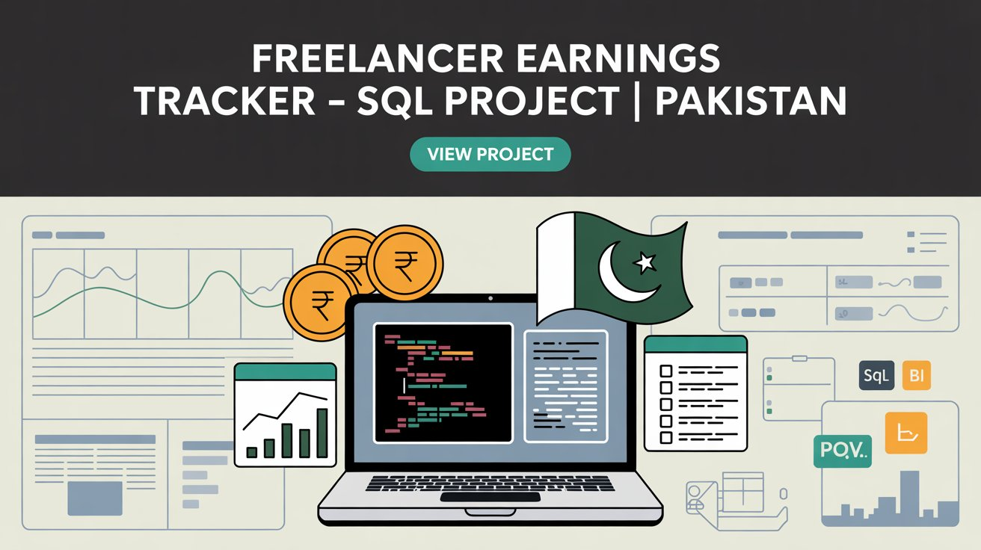

Slide 2
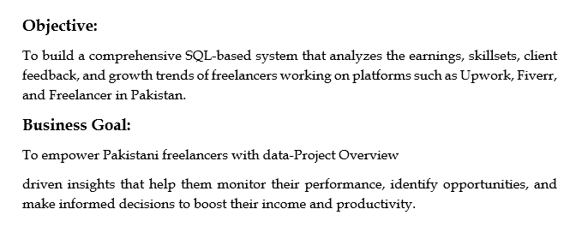
Project Overview

Slide 3
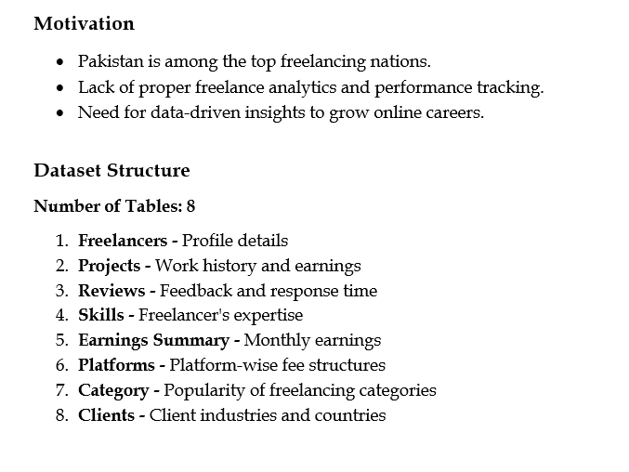

Slide 4
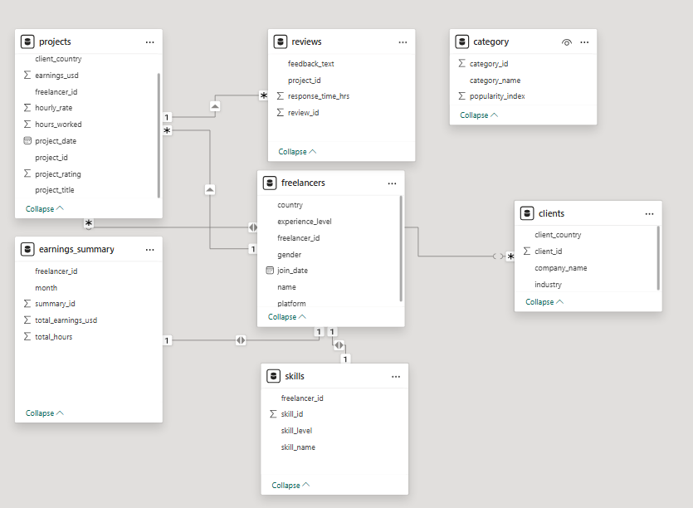
Schema Creation (Sample)

Slide 5
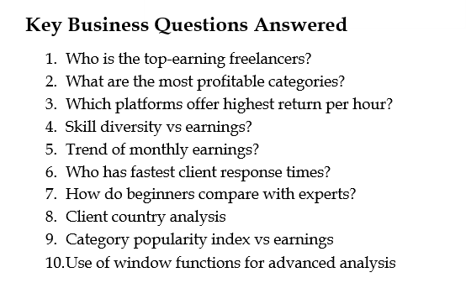

Slide 6
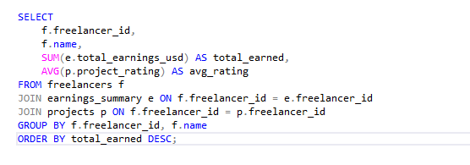
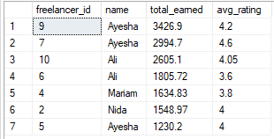
1. Which freelancers have the highest total earnings, and what is their average project rating?

Slide 7
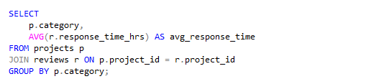
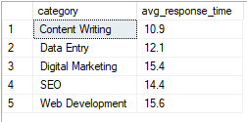
2. What is the average response time by project category?

Slide 8
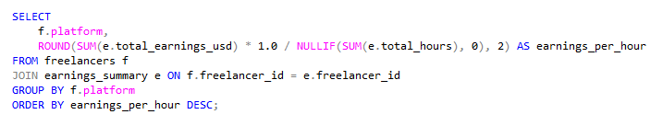

3. Which platform is associated with the highest average freelancer earnings per hour?

Slide 9
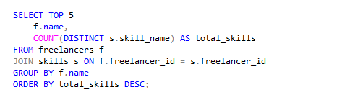
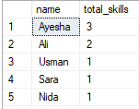
4. List top 5 freelancers with the most diverse skillsets.

Slide 10
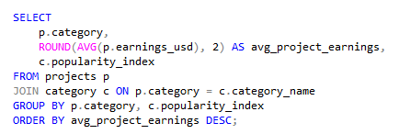
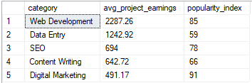
5. Which categories have the highest average project earnings and popularity index?

Slide 11
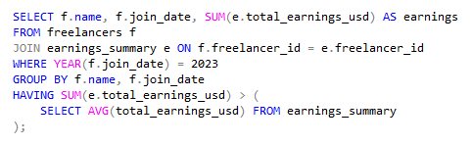

6. Find freelancers who joined in 2023 and earned above the average freelancer earnings.

Slide 12
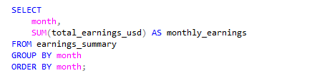
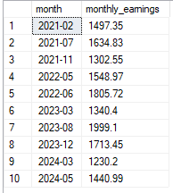
7. Show the monthly trend of total freelancer earnings

Slide 13
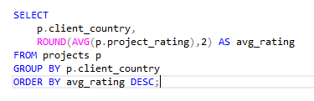
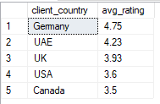
8. Which clients hired freelancers with the highest average ratings?

Slide 14
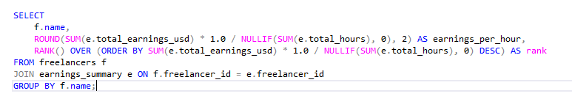
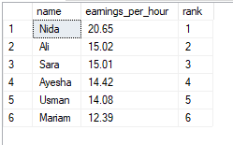
9. Rank freelancers by their average earnings per hour using window functions.

Slide 15
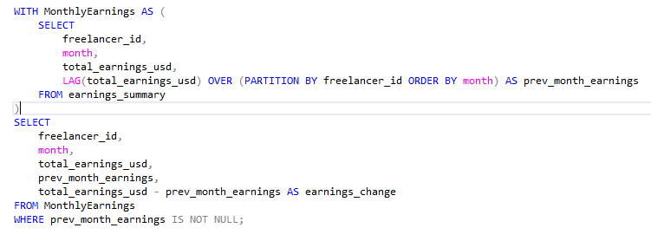
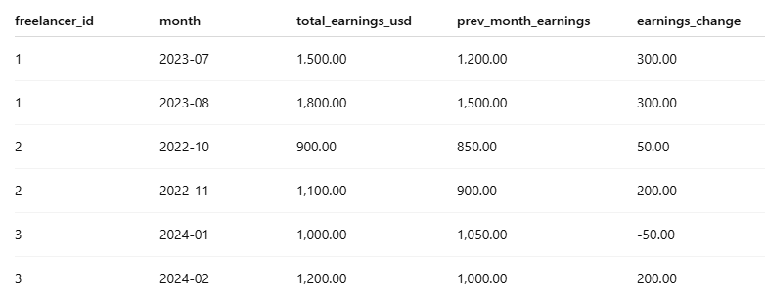
10. For each freelancer, compare their latest month’s earnings with their previous month.

Slide 16
Insights & Outcomes
Top 20% freelancers earn 60%+ of total revenue
SEO & Digital Marketing are high-paying categories
Fast responders have higher project ratings
Upwork leads in hourly earnings; Fiverr has more beginners
Monthly earnings fluctuate seasonally

Slide 17
Recommendations for Freelancers
Focus on High-Paying Skills: Skills like SEO, Digital Marketing, and Web Development consistently lead to higher earnings. Consider upskilling in these areas.
Improve Response Times: Freelancers with faster response times tend to get better reviews and more repeat clients. Use mobile apps or browser alerts to stay responsive.-
Choose Platforms Strategically: Upwork shows higher hourly returns, making it ideal for experienced professionals. Fiverr is better for building a portfolio if you're just starting out.-
Diversify Your Skillset: Data shows that freelancers with multiple skills earn more. Consider combining complementary skills (e.g., graphic design + video editing).-
Track Your Monthly Growth: Monitor your earnings regularly. Look for patterns in your income to plan better and scale your efforts during high-earning months.
Explore International Clients: Clients from tech and finance industries in countries like the USA, UK, and UAE offer higher budgets. Focus on optimizing your profile for these markets.
Treat Freelancing Like a Business: Use data to guide decisions — from pricing and skills to platforms and response strategies. Your freelance work deserves the same structure as a full-time job.---

Slide 18
Skills Demonstrated
SQL Joins, Aggregations, Window Functions
Subqueries, CTEs, Filters, Grouping
Data Modeling & Normalization
Analytical Thinking for Business Insights

Slide 19
What I Learned
Built complex SQL queries to answer real-world questions
Created a clean relational schema and data model
Gained confidence in storytelling with data
Understood freelancing market trends in Pakistan

Slide 20
Thank You!
Name: Khurram Naveed Connect: LinkedIn
GitHub : Portfolio Project: Freelancer Earnings Tracker (SQL Server)

